Slide 1
Chess Display and Computers

Slide 2
Session Objectives
Have Some Fun
Demonstrate Chess Display
Show Relationship Between Chess and Computer

Slide 3
Chess Display
NOT Playing Chess
Display Chess Position
Support Chess Analysis

Slide 4
Chess Display Program
Display Board
Show Chess Game
Move, Unmove
Automated or Manual
Examine Recorded Games
Notes:
Bobby Fisher – “Game of the Century”

Slide 5
Program Demo
Game of the Century
Bobby Fischer vs Donald Byrne
Marshall Chess Club in New York City
October 17, 1956
Very Brief View
Notes:
Bobby Fisher – “Game of the Century”

Slide 6
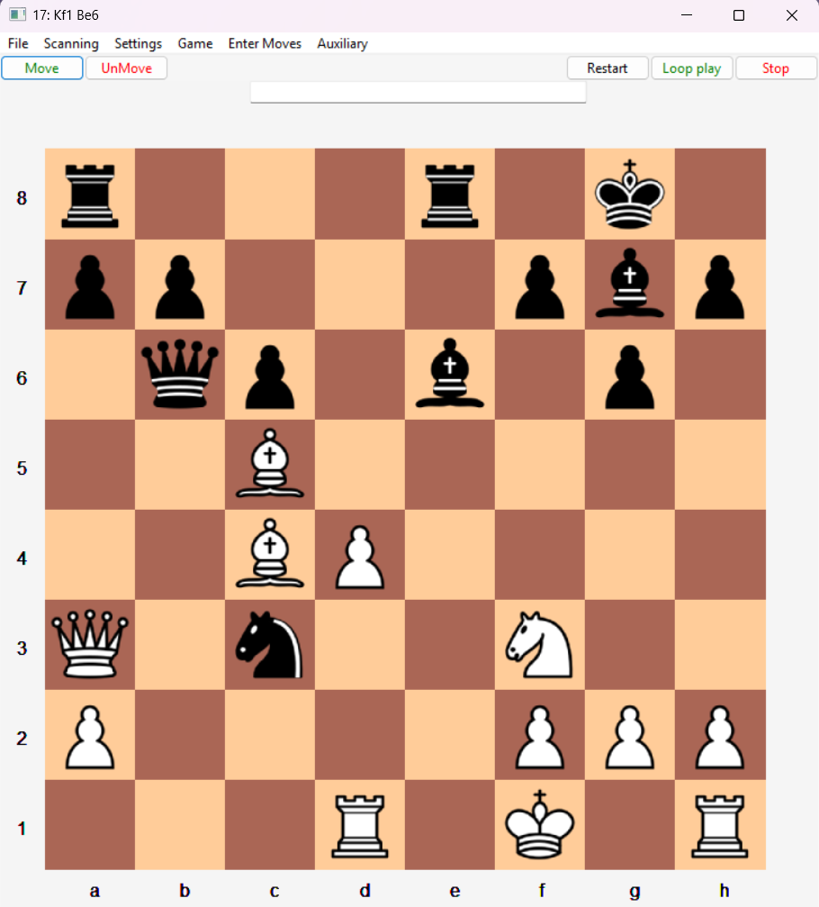

Slide 7
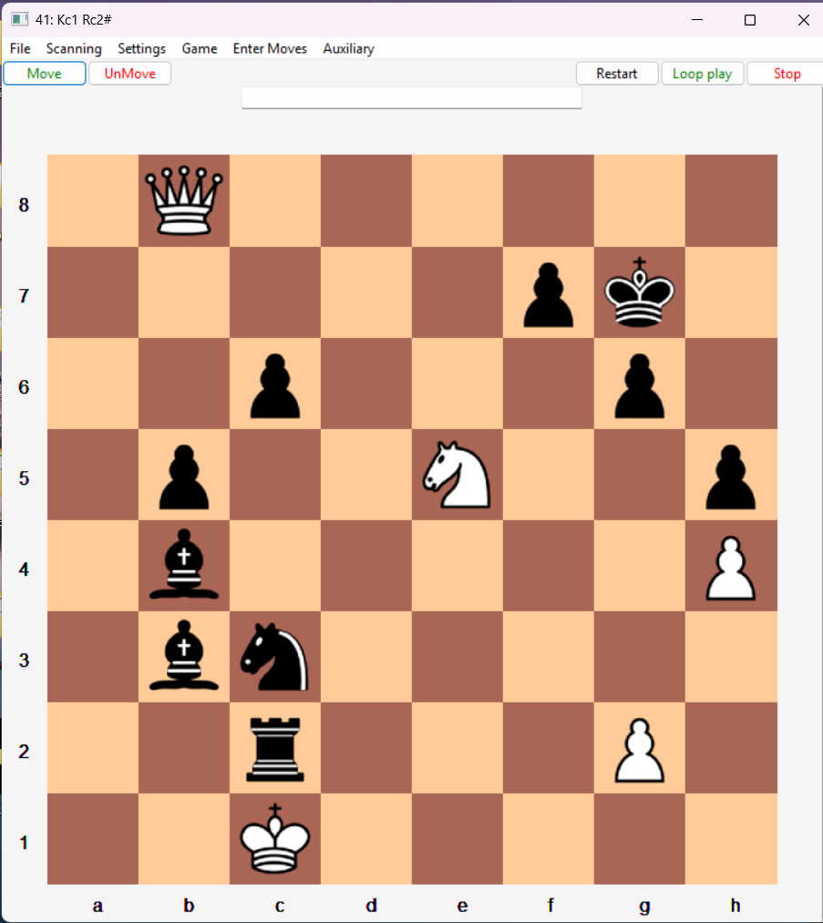

Slide 8
Game of the Century – Portable Game Notation
[Event "Third Rosenwald Trophy"]
[Site "New York, NY USA"]
[Date "1956.10.17"]
[EventDate "1956.10.07"]
[Round "8"]
[Result "0-1"]
[White "Donald Byrne"]
[Black "Robert James Fischer"]
[Result "0-1"]
[WhiteElo ""]
[BlackElo ""]
[ECO "D97"]

Slide 9
Game of the Century
1.Nf3 Nf6 2.c4 g6 3.Nc3 Bg7 4.d4 O-O 5.Bf4 d5 6.Qb3 dxc4 7.Qxc4 c6 8.e4 Nbd7
9.Rd1 Nb6 10.Qc5 Bg4 11.Bg5 Na4 12.Qa3 Nxc3 13.bxc3 Nxe4 14.Bxe7 Qb6 15.Bc4 Nxc3
16.Bc5 Rfe8+ 17.Kf1 Be6 18.Bxb6 Bxc4+ 19.Kg1 Ne2+ 20.Kf1 Nxd4+ 21.Kg1 Ne2+
22.Kf1 Nc3+ 23.Kg1 axb6 24.Qb4 Ra4 25.Qxb6 Nxd1 26.h3 Rxa2 27.Kh2 Nxf2 28.Re1 Rxe1
29.Qd8+ Bf8 30.Nxe1 Bd5 31.Nf3 Ne4 32.Qb8 b5 33.h4 h5 34.Ne5 Kg7 35.Kg1 Bc5+
36.Kf1 Ng3+ 37.Ke1 Bb4+ 38.Kd1 Bb3+ 39.Kc1 Ne2+ 40.Kb1 Nc3+ 41.Kc1 Rc2+ 0-1

Slide 10
Programming Challenges
Display – Board, Chess Pieces, Menu
Game display – move, unmove, Go To Move
Interpret notation – Nf3, c4, …
Portable Game Notation - PGN
Forsyth-Edwards Notation - FEN

Slide 11
Chess Move Notation
Record chess moves
Saving games
Recovering games

Slide 12
Algebraic Chess Move Notation
Move, Piece, Destination e.g., 1. Nf3
Pieces: King Queen Biship kNight Rook Pawn (usually P is omitted)
Destination: file(column), rank(row)
1. Nf3 - White Knight move to square at file-f, rank-3

Slide 13
Chess Interpretation Challenges
Notation Parsing
Movement spec -> piece + destination
Locate piece(s)
Resolve ambiguities
Recognize invalid moves

Slide 14
Chess Move Notation – Example: 1. Nf3
Determine move, piece, destination
1. Nf3 = white’s move 1, Knight, to square f3
16… Rfe8+ = black move 16, Rook on f file, to square e8 with check

Slide 15
Move Parsing – onion skin approach
In stages downward, removing, if found
Game Result: 1-0, 0-1, ½-½ - DONE
From tail: + check, # checkmate
Unique: O-O, O-O-O – DONE
From tail: promotion e.g., =Q
From tail: destination e.g., e8
From tail: capture (x)

Slide 16
Move Parsing – onion skin - continued
From left: Piece, e.g., K
From left: source file, e.g., f
From left end: source rank, e.g., 1

Slide 17
Chess Move Notation - Disambiguation – Example: 16… Rfe8+
Parse 16… Rfe8+ into black rook in file-f to square e8 with check
Determine that the only black rook in the file-f that can move to e8 is the rook starting in f8

Slide 18
Finding Piece Requires Move Knowledge
Find piece(s) specified by move
What piece can reach destination?
What squares can each legally reach?

Slide 19
How the Pieces Move (in computer eyes)
Handle ALL pieces, ALL places
Hopefully one plan for all pieces
Q,B,R – One or more squares in same direction
K - one square
N – One jump
P – One or Two (optional on first)

Slide 20
How the Pieces Move (in computer eyes)
Move/Capture in a direction
Move directions, as number pairs
(-1,1) (0,1) (1,1)
(-1,0) piece (1,0)
(-1,-1) (0,-1) (1,-1)
(-:left, 0:same, +:right, -:down, 0:same, +:up)
Arithmetic calculates destinations

Slide 21
Pawn Move Lists
pawn – list of directions:
Third entry for move /capture
white: (0,1,"move"), (-1,1, "capture")
(1,1,"capture")
black: (0,-1,"move"), (-1,-1, "capture"),
(1,-1,"capture")],
Notes:
Table reverses up(1) with down(-1) for black

Slide 22
White Pawn Moves / Captures
(-1,2) (0,2)Move* (1,2)
(-1,1)Capt (0,1)Move (1,1)Capt
(-1,0) White Pawn (1,0)
(-1,-1) (0,-1) (1,-1)
* - optional on first move

Slide 23
Black Pawn Moves/Captures
(-1,1) (0,1) (1,1)
(-1,0) Black Pawn (1,0)
(-1,-1)Capt (0,-1)Move (1,-1)Capt
(-1,-2) (0,-2)Move* (1,-2)
* - optional on first move

Slide 24
More Piece Move Lists
Knight: (1,2), (2,1), (2,-1), (1,-2),
(-1,-2), (-2,-1), (-2,1), (-1,2)
Bishop: (1,1), (1,-1), (-1,-1), (-1,1)
Rook: (0,1), (1,0), (0,-1), (-1,0)
Queen: Rook + Bishop
B,R,Q: multiples in that direction
King: = Queen, only 1 square

Slide 25
Find possible piece’s destinations
Very simplified algorithm
For each direction in piece’s list:
Repeat with current direction:
Look in direction, to new square
If obstacle [board edge, our color piece, in check]: Go to next direction
Add square to destination list
If capture: Go to next direction

Slide 26
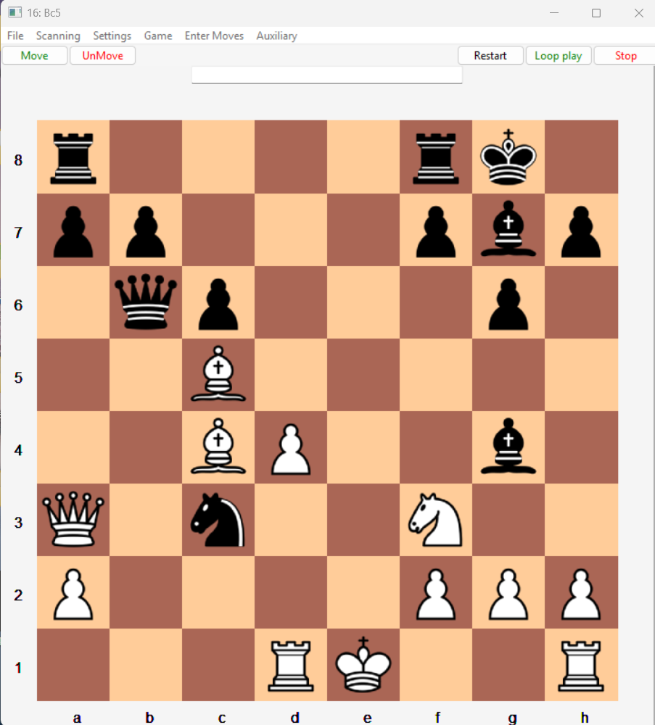

Slide 27
Destination squares after 16. Bc5 for Rook at F8
(move direction): square - result
(-1,0): e8, (-1,0): d8, (-1,0): c8, (-1,0): b8 (-1,0): a8 - obstacle: our color piece
Destination list: e8, d8, c8, b8

Slide 28
Question and Answer

